Slide 1
Lab 4: Keypad Scanning
ECE 0202

Slide 2
Lab Outline
Download assembly template project from canvas
Enable peripheral GPIO pins (4 output, 4 input)
Write logic to determine which button is pressed
Write that character to TeraTerm (through UART)
Show us the working keypad (checkoff)
Show us that debouncing is implemented (checkoff)
Submit code (e.g. ‘main.s’) on canvas
Submit pre-lab and post-lab questions on canvas

Slide 3
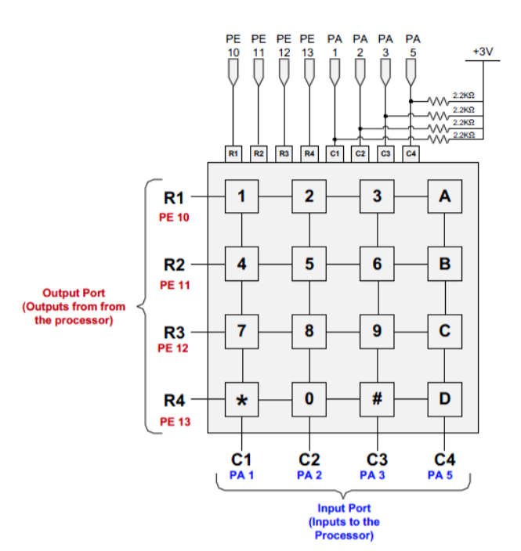


The Circuit
Our output pins drag down the voltage of our input pins when a button is pressed
We need external pull-up resistors for our input pins
Not mandatory, but can configure the output pins to open-drain instead of push pull to prevent short circuit
PA1
PE10
1

Slide 4
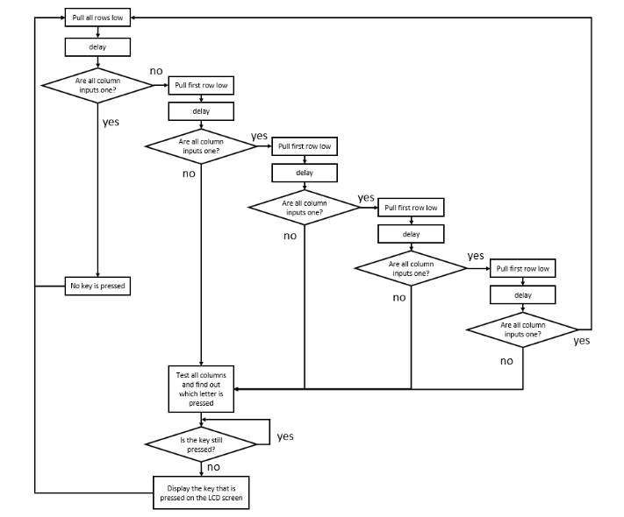
Writing the Logic
Every “split” of the flowchart should be a conditional statement
Idea is to find the row of the pressed button first, then the column

Slide 5
Delays/Software Debouncing
Delay 1: needed in between each change of the output pins (primarily due to capacitors on the input pins)
...also provide debouncing (trace flowchart)
Delay 2: once the button is pressed, wait until it is not pressed anymore

Slide 6


Writing to Tera Term
Using the help of a function in UART.c, which makes our life easy!
void USART2_Write(uint8_t* buffer, uint32_t nBytes)
Argument 1 is a pointer to a buffer of bytes - Load this into R0
Argument 2 is how many bytes are in the buffer - Load this into R1
Branch and link to USART2_Write
Example of how to declare a string of bytes called “str”
Example of how to declare a single word called “char1”

